Slide 1

PROJECT
Data Movement Pipeline
SUBMITTED BY: Pradip Bochare

Slide 2

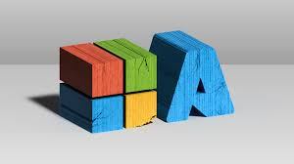
PROJECT
STATEMENT
Use Azure Data Factory to move data from an on-premises database to Azure Synapse Analytics & explain the process of the data movement pipeline.

Slide 3
Project Overview
Welcome to the Data Movement Pipeline project on Azure! This project is designed to showcase how various Azure services can be utilized to ingest, store, transform data. This project provides a data engineering and analytical journey on the sample dataset. Starting with a CSV file which is stored in Azure Data Lake Gen 2 is copied into the Azure Synapse Analytics via Azure Data Factory. It's initially stored in Azure Data Lake Storage Gen2, then transformed in Azure synapse analytics. The final output is shown as data stored in ADLS gen 2 is copied to dedicated SQL pool in Azure Synapse Analytics.

Slide 4

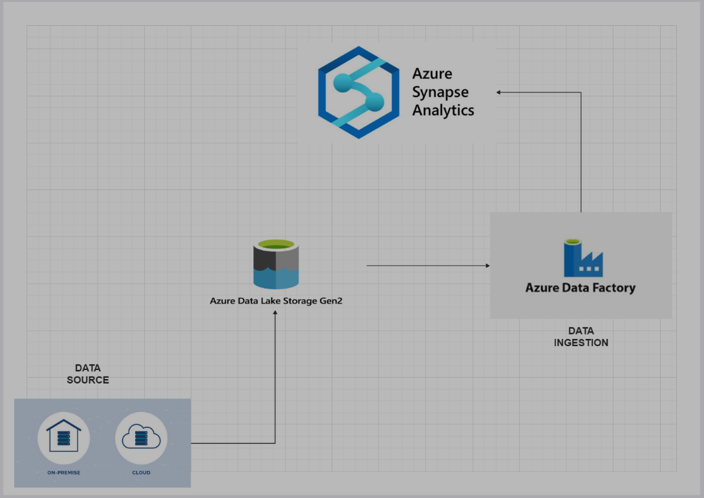



Process Flow
Architectural Diagram
End to End pipeline architecture in azure

Slide 5


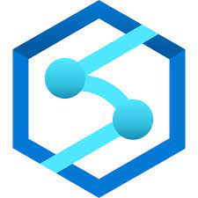
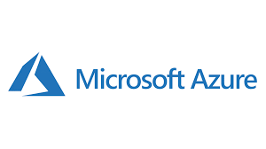
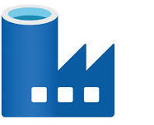
Azure Resource Used
Azure Data Lake Storage Gen2
Azure Synapse Analytics
Azure Data Factory

Slide 6

Project Requirement
Azure Data Lake Storage Gen2 (ADLS Gen2): ADLS Gen2 will serve as the central data repository for storing raw and processed data in a scalable and secure manner.
Azure Synapse Analytics: Azure Synapse Analytics will be used for data processing, including data transformation, aggregation, and analysis to derive insights from the stored data.
Azure Data Factory: Azure Data Factory will orchestrate data pipelines, facilitating the extraction, transformation, and loading of data from various sources into ADLS Gen2 and Azure Synapse Analytics.

Slide 7






Implementation
1)Azure Environment Setup
2)Data store and management with ADLS gen2
3)Data Ingestion with Data Factory
4) Setting up Azure Synapse
5) Making Dedicated SQL pool for data movement

Slide 8
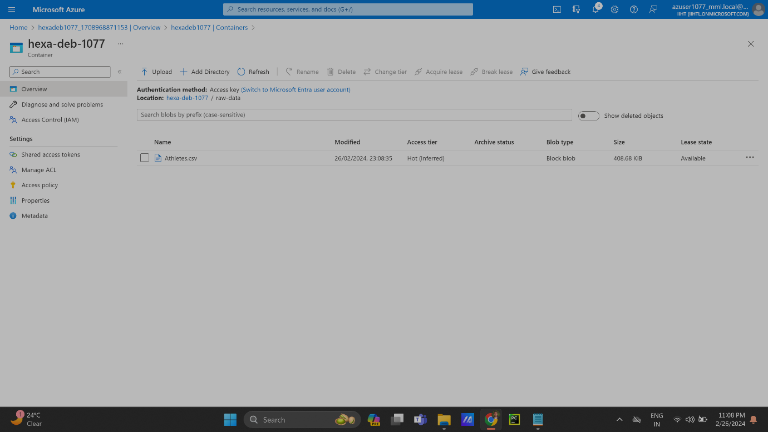
Implementation
The execution process for building a data movement pipeline using ADLS Gen2, Azure Synapse Analytics, Azure Data Factory:
1)AZURE SETUP ENVIRONMENT
2) Data store and management with ADLS gen2

Slide 9
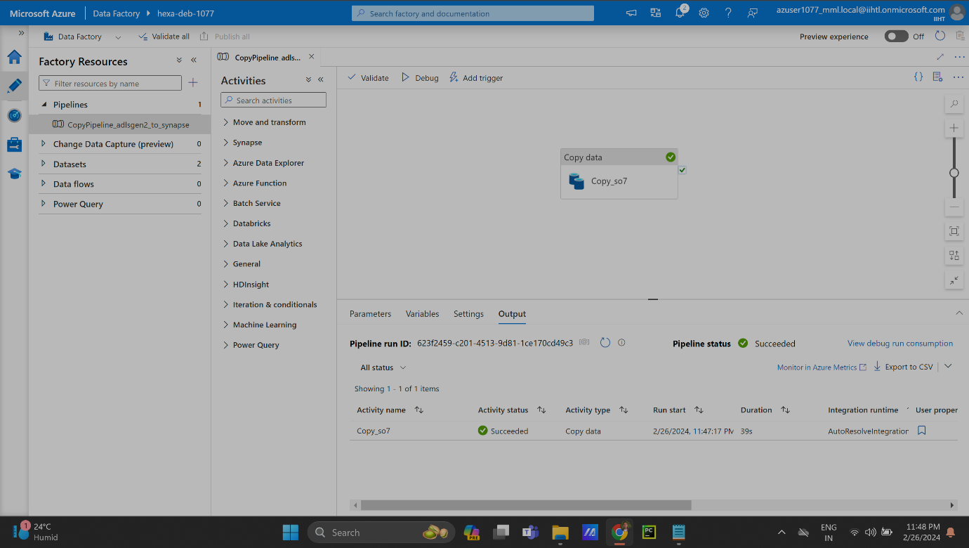
Implementation
3)Data Ingestion with Data Factory:Making data movement pipeline to copy data from ADLS Gen 2 to azure synapse using Azure Data Factory

Slide 10
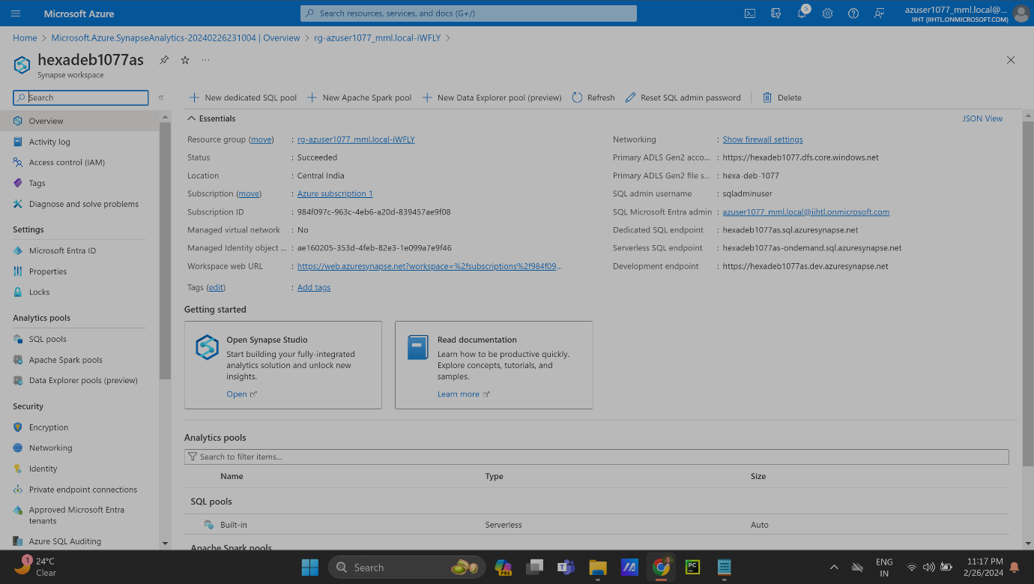
Implementation
4) Setting up Azure Synapse :Setting up Azure Synapse Analytics where destination for the data is. We are going to set up synapse to move data from ADLS to synapse

Slide 11
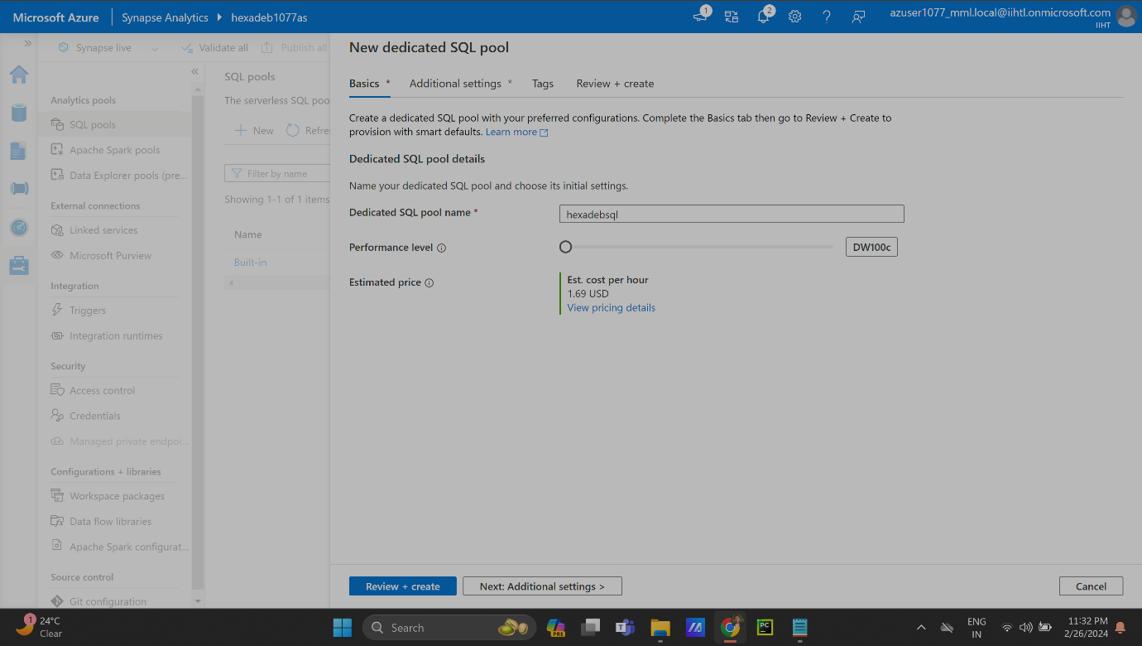
Implementation
5) Making Dedicated SQL pool for data movement: Here we made dedicated SQL pool for data movement.

Slide 12
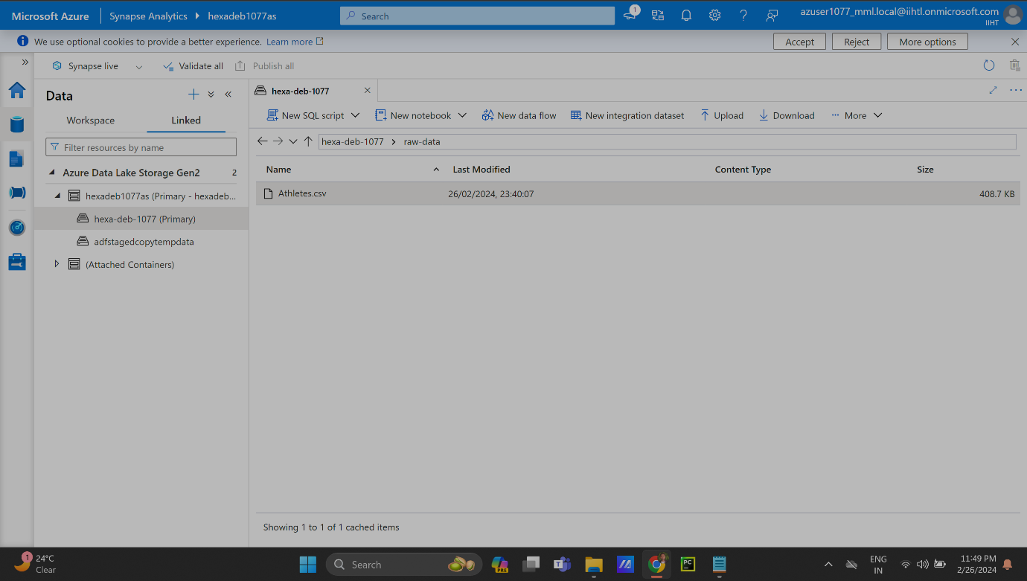
Implementation
6)Result: The result is of this project is that data is copied from ADLS Gen 2 to Azure Synapse using Azure Data Factory

Slide 13

TECHNOLOGIES USED
Azure Data Lake Gen2
Azure Data Factory
Azure Synapse Analytics

Slide 14
CONCLUSION
The conclusion of the project to build a data movement pipeline is the project successfully achieved its objective of creating data movement pipeline that moves data from ADLS Gen 2 to Azure Synapse Analytics using Azure Data Factory. Azure Data Factory effectively orchestrated data pipelines, ensuring seamless and reliable data ingestion from various sources into ADLS Gen2 and Azure Synapse Analytics. The Data Movement Pipeline provides the users to move data from ADLS Gen 2 to Azure Synapse using Data factory. This pipeline can run recursively to copy data which is added in storage account frequently.

Slide 15
Thank you

